Slide 1

Image cryptography using Elliptic curve cryptography and Magic matrix with Advanced encryption standard
GROUP MEMBERS:
DERIL RAJU (BE/10489/16)
MUPPIDI SAI PRANAV (BE/10488/16)
LALITHA ELESWARAPU (BE/10435/16)
Guide:
Mr. Rupesh Kumar Sinha

Slide 2
Contents
Motivation
Introduction
Objective
Literature Review
Methodology
Results and discussions
Future Works
References

Slide 3
Motivation
Most of the modern data is transferred via internet, if no proper encryption standards are used they can be easily accessed by people who are not meant to receive it.
Many sectors like banks, IT companies and social media have the risk of disclosure of sensitive information.
Thus, we felt the need to develop an image encryption standard which can withstand robust hacking techniques without compromising the speed and reliability of the system.

Slide 4
Introduction
Image Cryptography is a widely used technique which has found great application in the fields of military and intelligence, social networking and financial services.
The main motto of cryptography is to service the growing need for increased security of information in various fields.
Objective
To design an efficient encryption/decryption scheme using Elliptic curve cryptography and Magic matrix scrambling technique with the help of AES encryption.

Slide 5
Literature Review
Padma Bh et al (2010) have presented a model to encode and decode messages using Koblitz’s Method in Elliptic Curve Cryptography.
Ali Soleymani et al (2013) have proposed a cryptosystem for image encryption/decryption using a novel mapping scheme involving elliptic curves.
K Mani & M Viswambari et al (2017) explained generation of key matrix for cipher using magic rectangle. Magic matrix can’t encrypt the image properly if the image is gray or if image consist of large area of same color. This drawback of magic matrix can be removed by using a proper key matrix. They proposed a deterministic method for generation of key matrix of higher order k from magic rectangle.
Pachamuthu Rajalakshmi et al (2010) have presented a compact hardware-software co-design of Advanced Encryption Standard (AES) on the field programmable gate arrays (FPGA) designed for low-cost embedded systems.

Slide 6
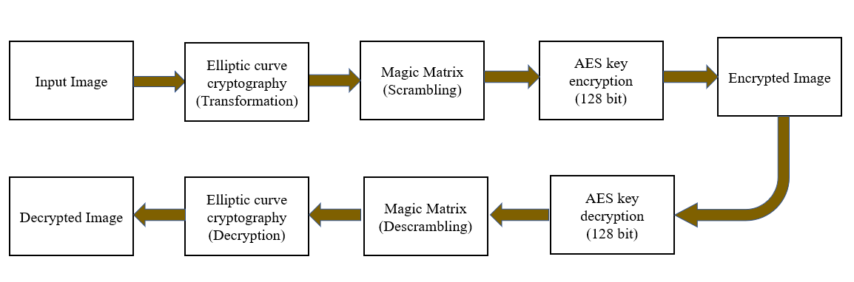
Block Diagram

Slide 7
Introduction to Elliptic curves
An elliptic curve is a plane curve defined by an equation of the form
y² mod p=(x³+ax+ b) mod p
a, b and p are known as elliptic curve parameters; ‘a’ and ‘b’ decide the shape of the curve, while ‘p’ decides the range
In our model, ECC has been used to transform pixel intensity values
With respect to the curve, ‘x’ refers to the original intensity value while ‘y’ refers to the transformed value

Slide 8
Encryption of pixel intensity values
Step1: An elliptic curve Ep(a,b) was chosen.
Step 2: Based on the value of p, range of the curve was determined
Step 3: An image was inputted and read as a matrix of pixel intensity values. These values range from 0(black) to 255(white).
Step 4: An auxiliary base parameter(k), for example k = 20, was chosen.
Step 5: An attempt was made to the solve the elliptic curve for x=mk+1 (for every mk), where m represents an individual pixel intensity value.
Step 6: If the curve could not be solved using x=mk+1, x=mk+2,3,4….(k-1) were given as inputs to the elliptic curve equation.
Step 7: A value of y was reached before reaching x = mk + k-1. Thus a point (x,y) was now obtained on the elliptic curve, which represented a value in the input matrix.
Step 8: The entire input image matrix was converted into a matrix of new points which represented solutions of the elliptical curve.

Slide 9
Modifications
Encryption of pixels was done by drawing parallels from Koblitz’s method of encoding text messages.
The values of ‘Y’ for respective ‘X’ on the elliptic curve can range from 0 to ‘p’.
Since pixel intensity values only ranged from 0 to 255; and diminishing the value of ‘p’ or base parameter ‘k’ could either lead to decreasing the range of operation or decreasing the probability of solving the curve with a particular value of x, the modulo operator (mod 255) was used for all the outputs obtained by solving the curve.
The values of quotient were stored in a separate array; they can later be used to reconstruct the ‘Y’ value, which can lead to the pixel intensity value of the original image, during decryption.

Slide 10
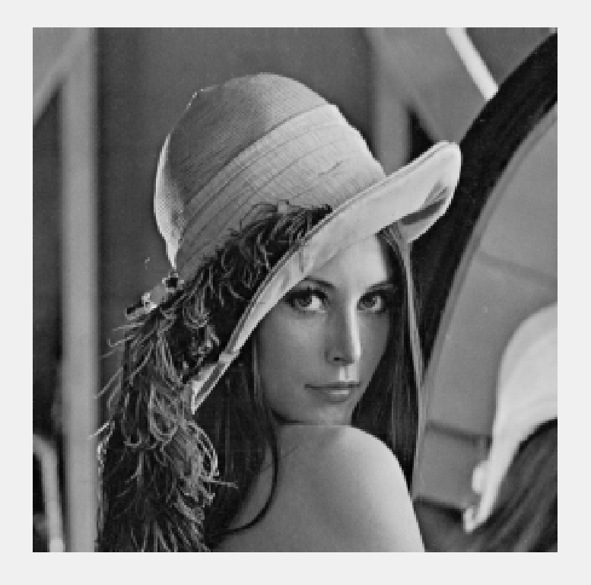
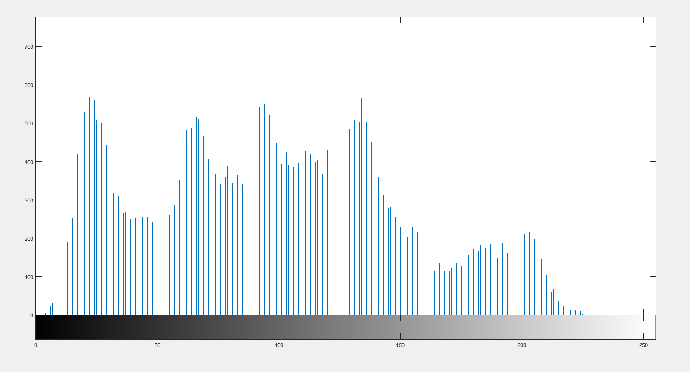
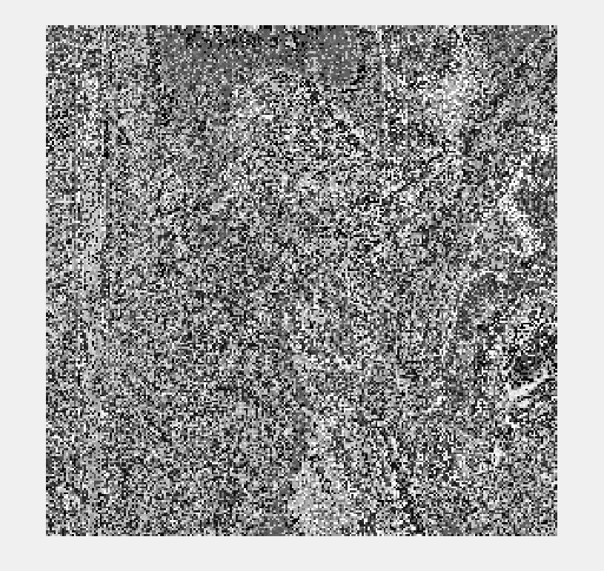
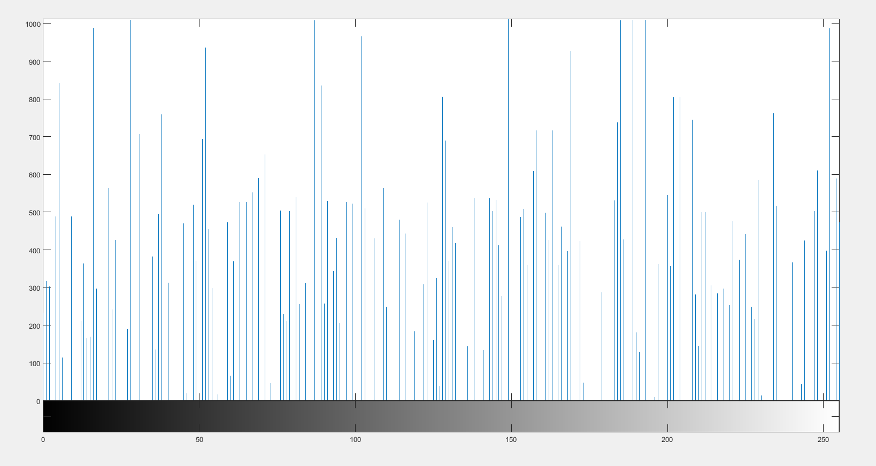
Results (ECC) Lena Image
Fig 1.a Input Image (Lena)
Fig 1.b Histogram of Input Image
Fig 1.c encrypted image(ECC)
Fig 1.d Histogram of encrypted image

Slide 11
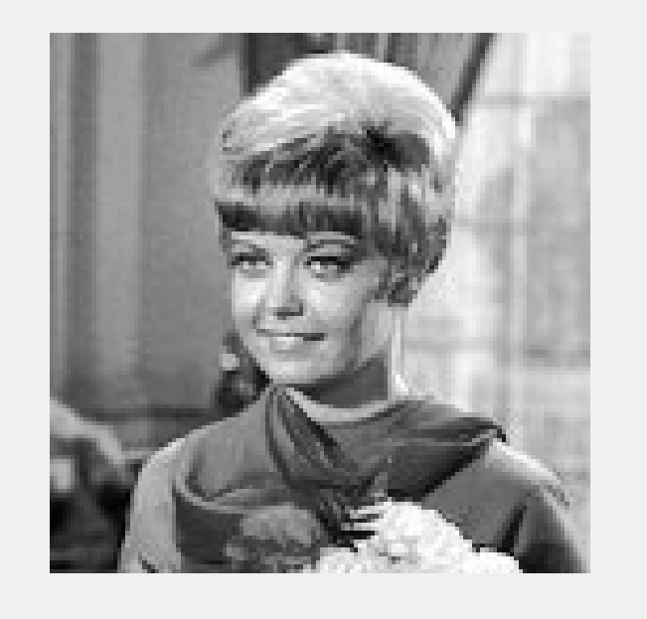
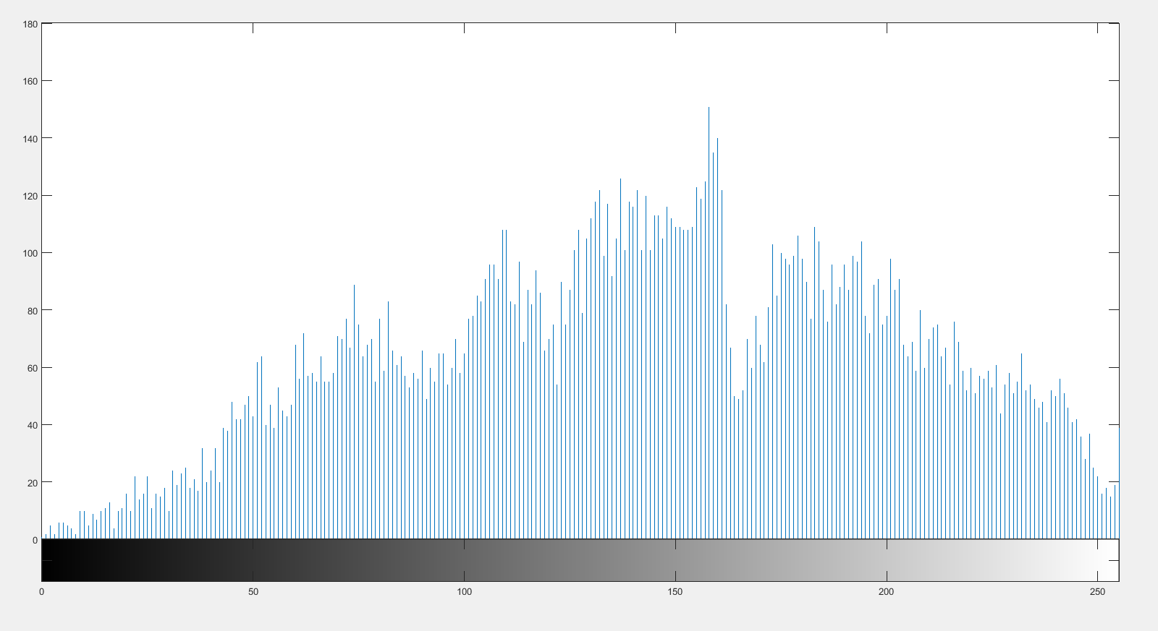
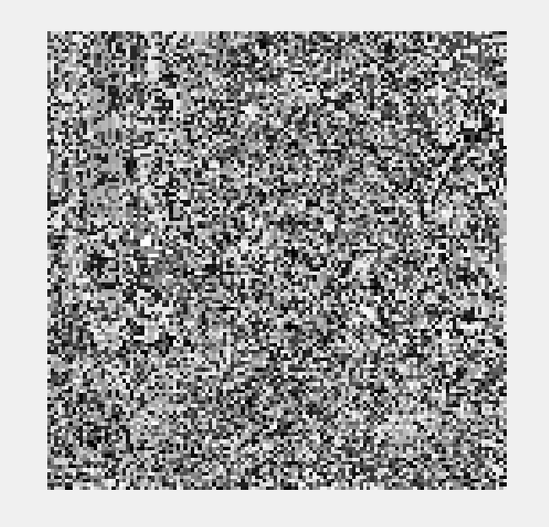
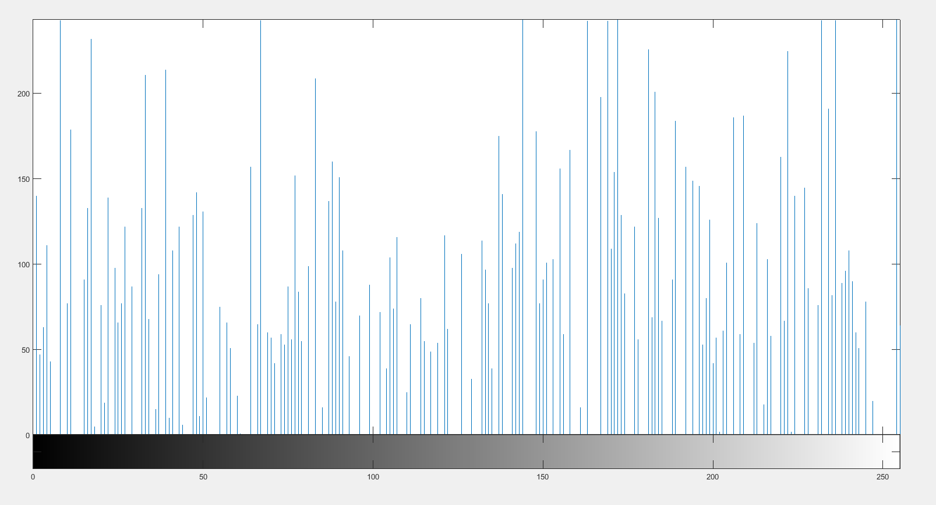
Results (ECC) Other Image
Fig 2.a Input Image
Fig 2.b Histogram of Input Image
Fig 2.c Encrypted Image
Fig 2.d Histogram of Encrypted image

Slide 12
Magic Matrix
A magic square is “magic” because it contains the property that the square consists of the distinct positive integers 1, 2, …,N ² (N>=3) such that the sum of the N numbers in any horizontal, vertical or main diagonal line is always the same magic constant.
For an NxN magic matrix, the sum of the rows or columns or diagonals can be given by N(N²+1)/2.
Magic matrix is used as a scrambling technique which scrambles the pixels of the image by position transformation.

Slide 13
Example of magic matrix
In the 3x3 matrix shown below, the values are arranged such that the sum of values in all the rows, columns and the diagonals is 15.
DIAG-1 SUM = 15
4 | 9 | 2
3 | 5 | 7
8 | 1 | 6
ROW SUM = 15
ROW SUM = 15
ROW SUM = 15
DIAG-2 SUM = 15
COL SUM = 15
COL SUM = 15
COL SUM = 15
Fig 3. 2x3 magic matrix

Slide 14
Construction of Magic Matrix
1. You start by placing the number 1 in any of the cells of your N x N magic square. (A ‘1’ in the top middle will give a perfect magic square, however, you can place the ‘1’ anywhere, the diagonals might not sum to the magic number.)
2. The next step is to place the next successive integer in the square above and to the right of the “1”.
◦Continue this last step until the square is filled.
3. The numbers wrap around the square, so when you reach the top of the square, wrap to the bottom row, and if you reach the right side, then wrap to the left.
4. When you come to the upper right corner drop down one row to continue filling numbers.
5. If you go to place the next number, x, in a cell that is already filled, then place x in the cell below x-1, the number you had just placed.

Slide 15
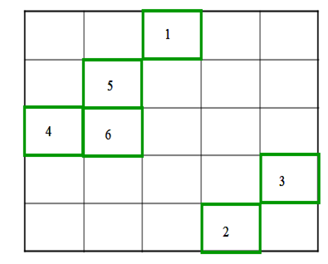
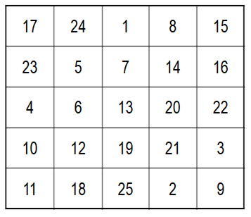

Construction of Magic Matrix
Fig 4. Magic matrix construction

Slide 16
Scrambling using magic matrix
The image matrix holding the pixel values in converted into a one dimension matrix.
The pixel values are hence arranged linearly with indices from 1 to N².
The magic matrix is traversed and each position is replaced by the pixel value that is contained in the index value that the position holds in the 1D matrix.

Slide 17
Modifications
The technique of magic matrix has been modified by changing the pixel values before scrambling. Hence the modified technique is a combination of both value transformation and position transformation.
All the pixel values of the input image are XORed and the result is stored in a variable.
This variable is again XORed individually with each pixel and the pixel value is replaced with this XORed value.
This transforms the value of each pixel in the matrix and this matrix is scrambled by using the magic matrix.

Slide 18
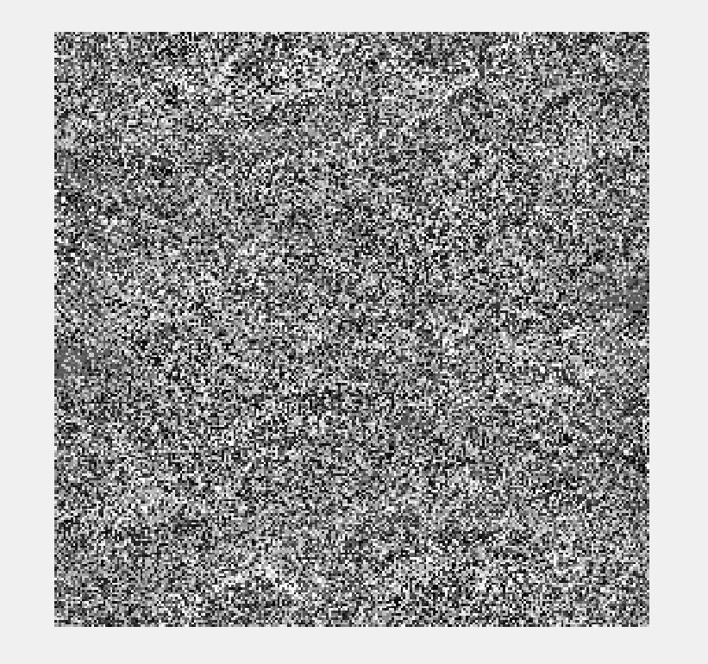
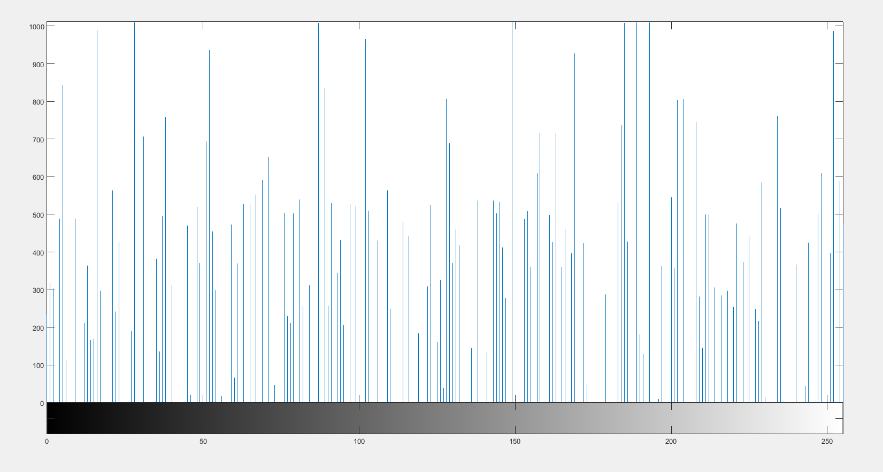
Results (Magic matrix) Lena Image
Fig 5a. Output image from ECC Block
Fig 5b. Histogram of ECC output image
Fig 5c. Encrypted image from magic matrix
Fig 5d. Histogram of encrypted image

Slide 19
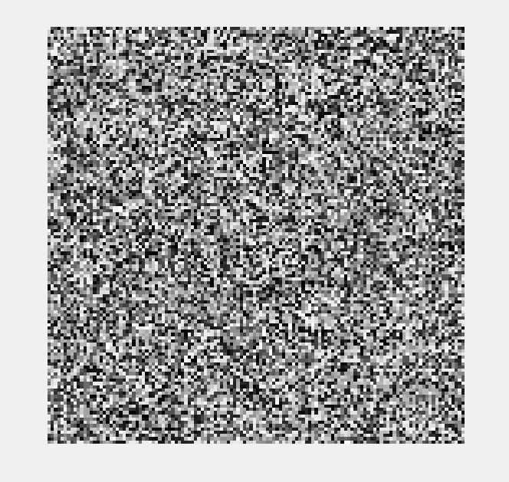

Results (Magic matrix) Other Image
Fig 6a. Output image from ECC Block
Fig 6b. Histogram of ECC output image
Fig 6c. Encrypted image from magic matrix
Fig 6d. Histogram of encrypted image

Slide 20
Advanced Encryption Standard (AES)
It uses higher length key sizes such as 128, 192 and 256 bits for encryption. Hence it makes AES algorithm more robust against hacking.
For 128 bit, about 2^128 attempts are needed to break. This makes it very difficult to hack it as a result it is very safe protocol.
AES repeats 4 major functions to encrypt data. It takes 128 bit block of data and a key and gives a ciphertext as output. The functions are:
Sub Bytes, Shift Rows, Mix Columns, Add Round Key
The number of rounds performed by the algorithm strictly depends on the size of key.
AES PARAMETERS:
Algorithm | Key length Nk | Block size Nb | No. of Rounds Nr
AES-128 | 4 | 4 | 10
AES-192 | 6 | 4 | 12
AES-256 | 8 | 4 | 14
Table 1. AES parameters

Slide 21
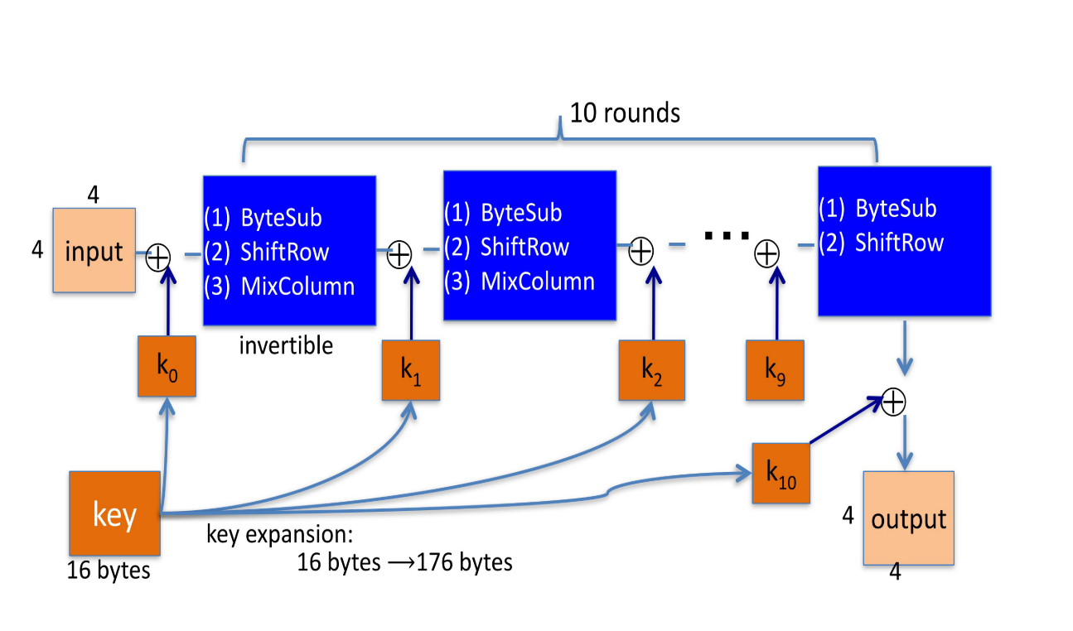
Fig 7. AES Encryption

Slide 22
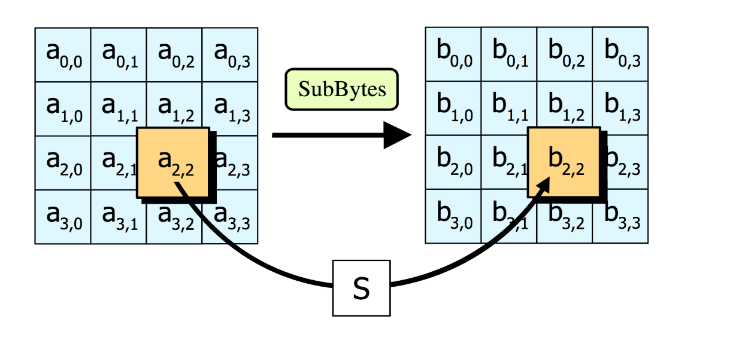
Step 1: Sub Bytes
Sub Bytes- Each element of the matrix is replaced by the an element of s-box matrix.
Fig 8. Sub bytes

Slide 23
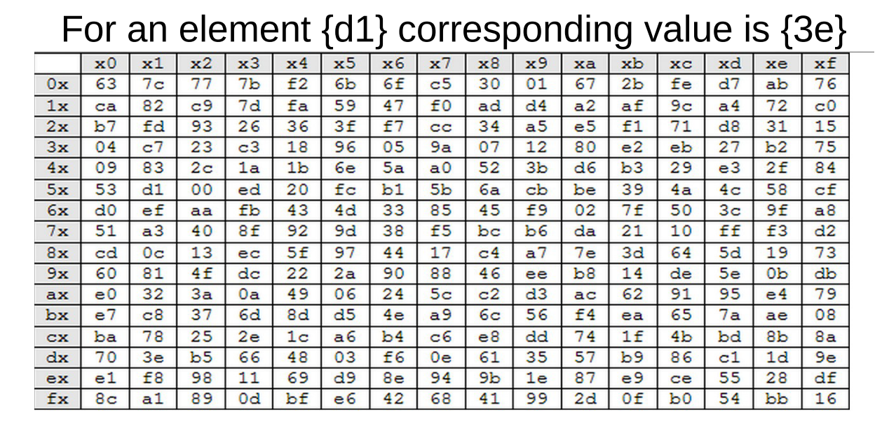
Fig 9. Rijndael S-Box

Slide 24
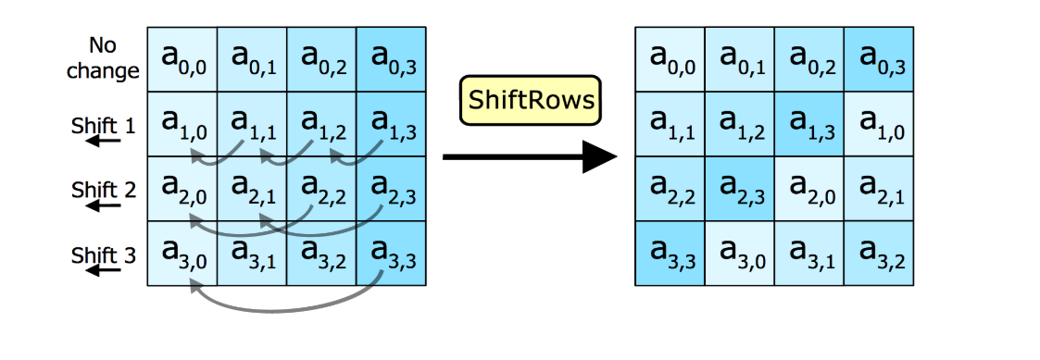
Step 2: Shift rows
In this step rows of the block are cylindrically shifted in left direction.
The first row is untouched , the second by one shift, third by two and fourth by 3.
Fig 10. Shift rows

Slide 25
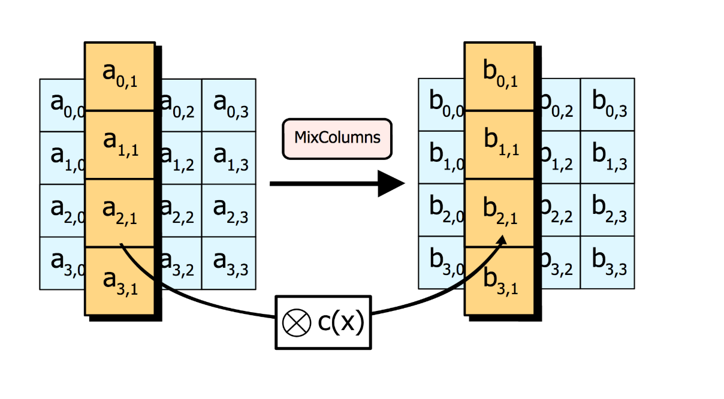
Step 3: Mix Columns
It causes the flip of bits to spread all over the block
In this step the block is multiplied with a fixed matrix.
The multiplication is field multiplication in Galois field.
For each row there are 16 multiplication, 12 XORs and a 4-byte output.
Fig 11. Mix columns

Slide 26
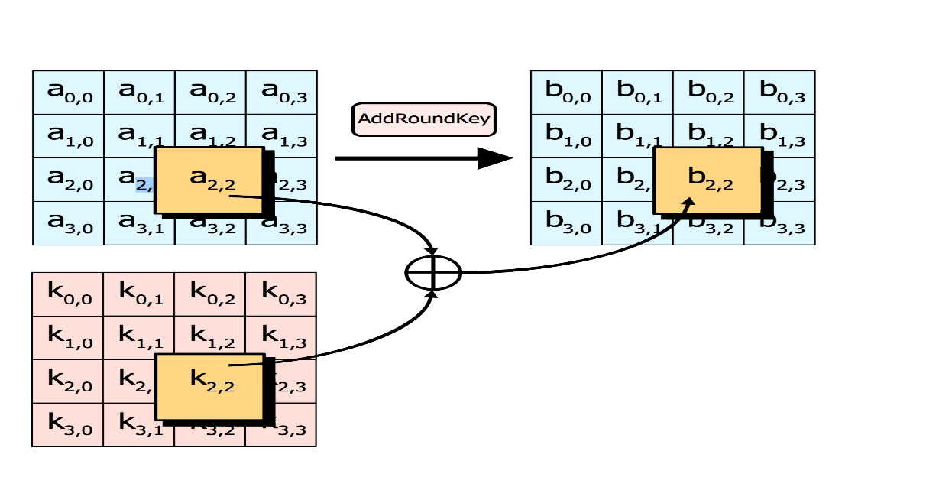
Step 4: Add round key
In this step each byte is XOR-ed with corresponding element of key's matrix.
Once this step is done the keys are no longer available for this step. Using the same key will weaken the algorithm.
To overcome this problem keys are expanded.
Fig 12. Adding round key

Slide 27
Modifications
AES was modified to take any size image input and break it into chunks of 16 byte blocks.
Key Generation algorithm was introduced which generates the key from the input image, the algorithm was to take every 16th byte from the input image as key until the size of the key becomes 128 bit. In case if the image size doesn't satisfy, then a random key was used for encryption.

Slide 28
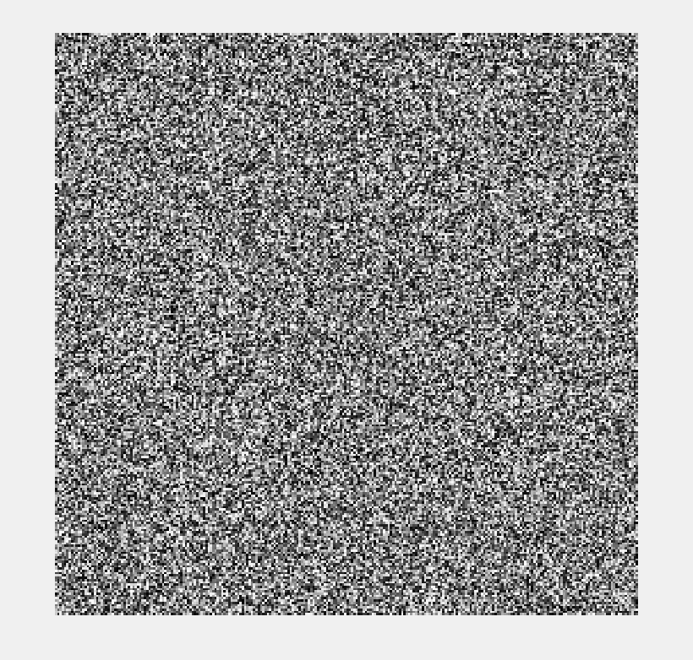
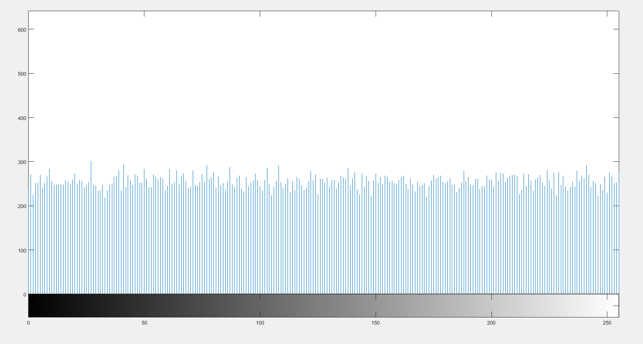
Final output Lena Image
Fig 13a. Input image (lena)
Fig 13b. Histogram of input image (lena)
Fig 13c. Final encrypted image (lena)
Fig 13d. Histogram of final encrypted input image (lena)

Slide 29
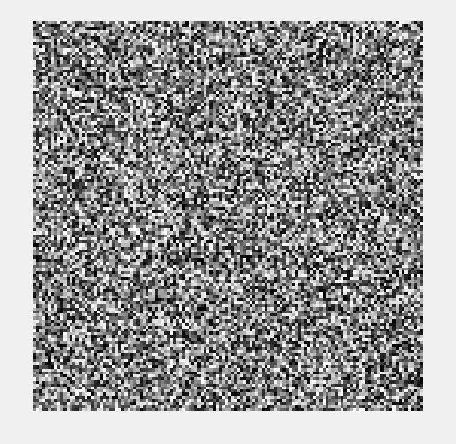
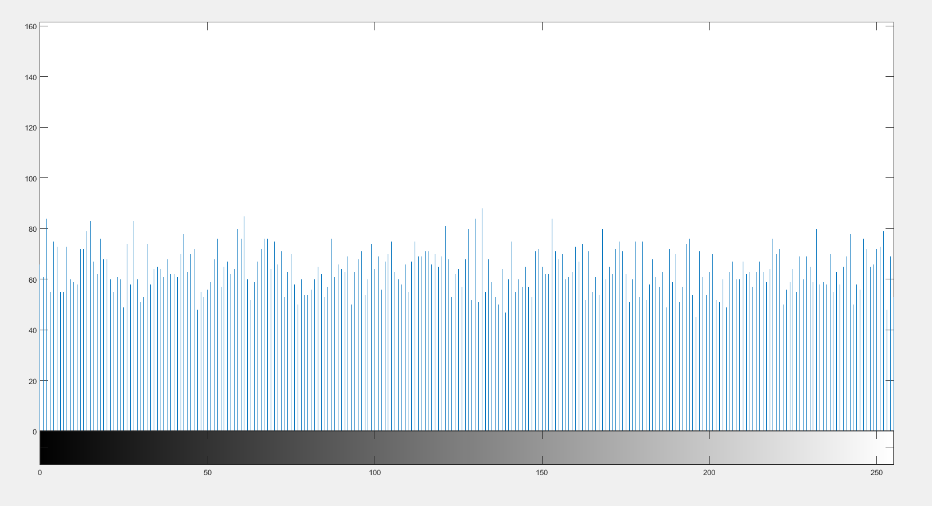
Final output Other Image
Fig 14a. Input image
Fig 14b. Histogram of input image
Fig 14c. Final encrypted image
Fig 14d. Histogram of final encrypted image

Slide 30

Results and Discussions
Parameters in consideration:
Number of changing pixel rate (NPCR) and Unified Averaged Changed Intensity(UACI): The NPCR measures the percentage of different pixels that change in two images which is the encrypted image when only one pixel is changed in the original image, while UACI measures the average intensity of differences between the original and encrypted images.
Entropy: Information entropy is a concept that tells how much information there is in an image. In general, the more uncertain or random the image is, the more information it will contain. It evaluate the scattering of pixel values in the image.
For grayscale images entropy is theoretically equal to 8.

Slide 31
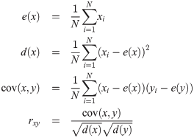
Correlation Coefficient: Correlation test consists of randomly selecting N pairs of adjacent pixels (vertical, horizontal, and diagonal) from the original and the encrypted images separately. Then, the correlation coefficient of each pair is calculated using
Key Sensibility: Encryption algorithms should also have high sensibility to encryption key. This means that any small change in the key should lead to a significant change in the encrypted, or decrypted, image.

Slide 32
Comparison of parameters
Methods | Parameters
 | Correlation Coefficient | Entropy | Sensitivity Analysis
 |  |  | NPCR | UACI
Proposed Method (lena image) | -0.000758 | 7.9975 | 0.9959 | 0.3068
Proposed method (Other image) | -0.00214 | 7.9871 | 0.9958 | 0.3061
Enhanced logistic map^{[6]} | −0.0237 | 7.996 | 0.9940 | 0.335
3D chaotic map^{[7]} | -0.0043 | 7.989 | 0.9952 | 0.335
Table 2. Parameter comparison

Slide 33
References
[1] Padma Bh, D.Chandravathi, P.Prapoorna Roja, “Encoding And Decoding of a Message in the implementation of Elliptic Curve Cryptography using Koblitz’s Method” International Journal on Computer Science and Engineering, Vol. 02, No. 05, 2010, 1904-1907.
[2] F. Amounas, E.H. El Kinani,”Security Enhancement of Image Encryption Based on
Matrix Approach using Elliptic Curve”, International Journal of Engineering Inventions, e-ISSN: 2278-7461, p-ISSN: 2319-6491 Volume 3, Issue 11 (June 2014) PP: 8-16.
[3] Srinivasan Nagaraj, Dr.G.S.V.P.RAJU, K.Koteswara rao, “Image Encryption Using Elliptic Curve Cryptography and Matrix”, International Conference on Intelligent Computing, Communication & Convergence, (ICCC-2014), doi: 10.1016/j.procs.2015.04.182.
[4] Megha Kolhekar and Anita Jadhav ”implementation of elliptic curve cryptography on text and image”, International Journal of Enterprise Computing and Business Systems, ISSN (Online): 2230-8849, 2011, vol. 1, Issue 2.
[5] Laiphrakpam Dolendro Singh, Khumanthem Manglem Singh, “Image Encryption using Elliptic Curve Cryptography”, Eleventh International Multi-Conference on Information Processing-2015 (IMCIP-2015), doi: 10.1016/j.procs.2015.06.054

Slide 34
[6] Priya Ramasamy, Vidhyapriya Ranganathan, Seifedine Kadry, “An Image Encryption Scheme Based on Block Scrambling, Modified Zigzag Transformation and Key Generation Using Enhanced Logistic—Tent Map” 21, 656; doi:10.3390/e21070656.
[7] Md. Billal Hossain, Md.Toufikur Rahman, A B M Saadmaan Rahman, “A new approach of image encryption using 3D chaotic map to enhance security of multimedia component”, Conference: 2014 International Conference on Informatics, Electronics & Vision (ICIEV) DOI: 10.1109/ICIEV.2014.6850856.
[8] Samiksha Sharma, Vinay Chopra, “ANALYSIS OF AES ENCRYPTION WITH ECC”, Proceedings of International Interdisciplinary Conference On Engineering Science & Management Held on 17th - 18th December 2016, in Goa, India.ISBN: 9788193137383.
[9] A. K. Mandal, C. Parakash, and A. Tiwari. "Performance evaluation of cryptographic algorithms: DES and AES."Electrical, Electronics and Computer Science (SCEECS), 2012 IEEE Students' Conference on. IEEE, pp 1-5.
[10] S. Sowmiya, I. Monica Tresa, A. Prabhu Chakkaravarthy, “Pixel based image encryption using magic square”, 2017 International Conference on Algorithms, Methodology, Models and Applications in Emerging Technologies (ICAMMAET), 10.1109/ICAMMAET.2017.8186634.
[11] D.I. George Amalarethinam, J. Sai geetha, "Enhancing Security Level for Public Key Cryptosystem Using MRGA", World Congress on Computing and Communication Technologies (WCCCT), pp. 98-102, 2014, ISBN 978-1-4799-2876-7.
[12] MATLAB 2015a and 2017a Summary and documentation.

Slide 35
Future Work
Decryption of all the three blocks
Adding a robust and secure, key distribution technique

Slide 36
Thank You

